Slide 1
Week 6 Presentation
11107014
林冠良

Slide 2
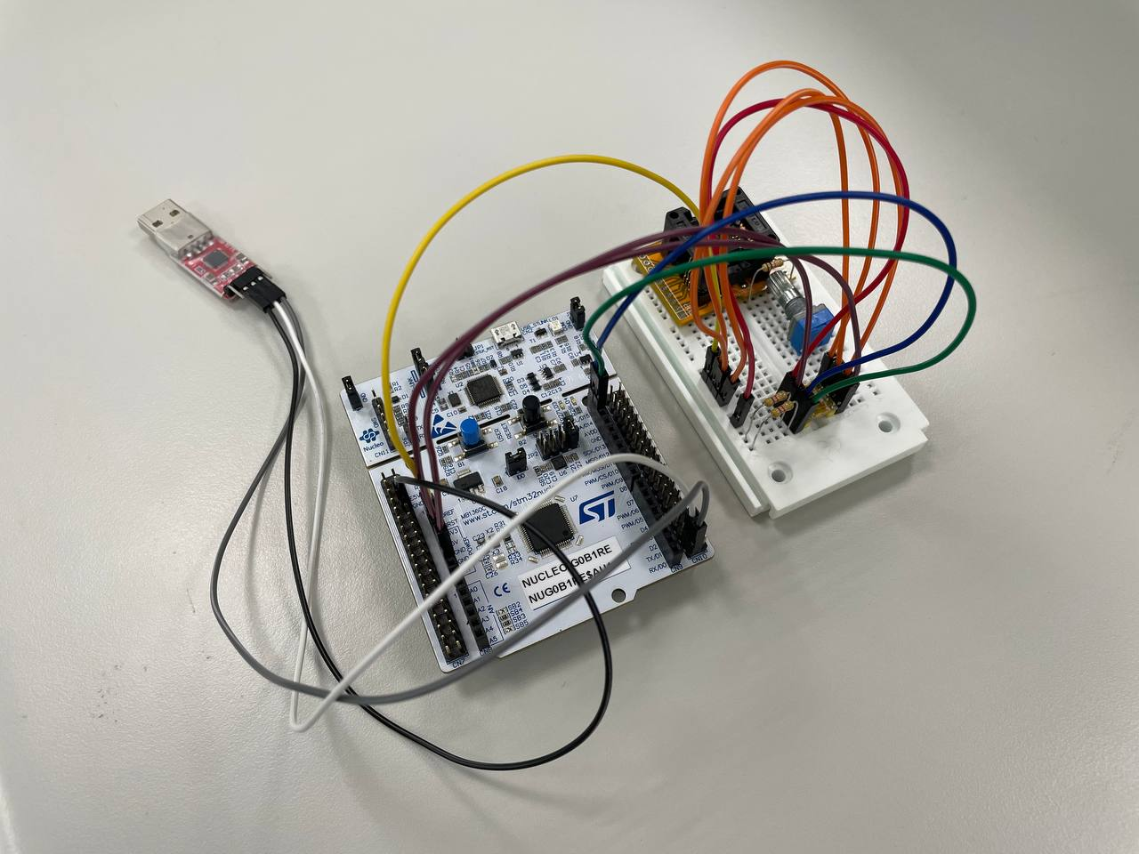
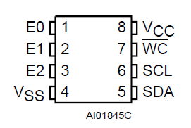
Circuit
E0, E1, E2 and VCC connected to 3V3 in series.
VSS and WC connected to GND.
SCL connected to D15.
SDA connected to D14.
UART_RX connected to PC4.
UART_TX connected to PC5.

Slide 3
Coding
I2C_Simulation

Slide 4
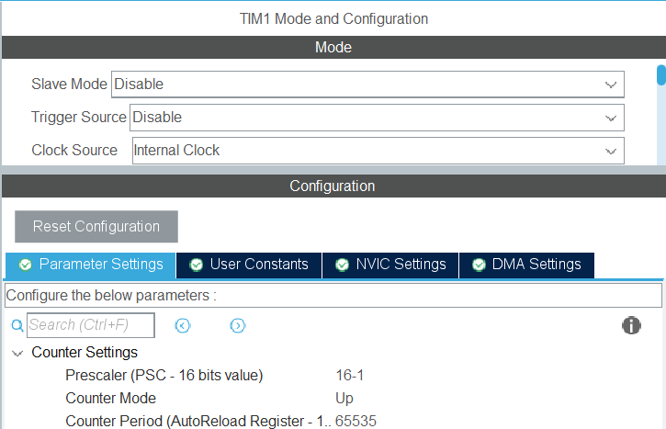
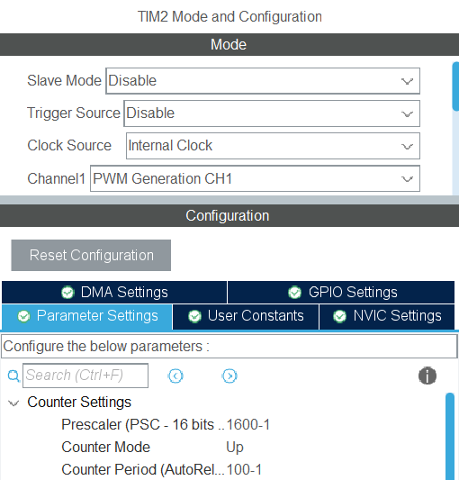
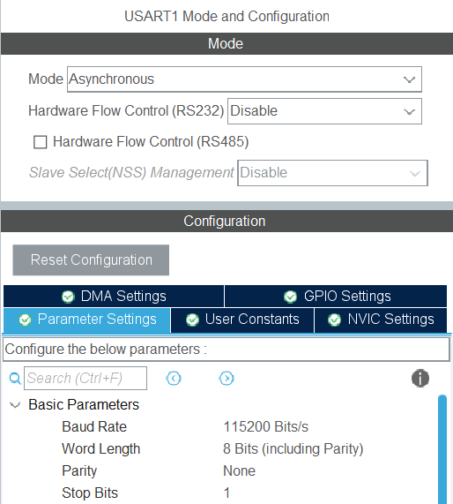
Enable each interface
TIM1
  Prescaler: 16-1 (1 tick per us)
I2C
  Speed Mode: Fast mode
Uart
  Mode: Asynchronous
  Baud Rate: 115200 bit/s
LD4
  GPIO Mode: TIM2_CH1

Slide 5
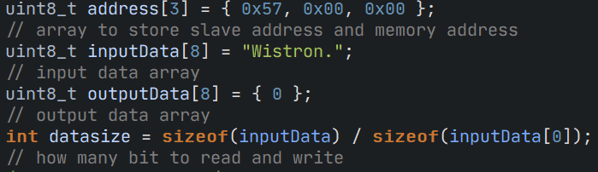
Initialize variables

Slide 6
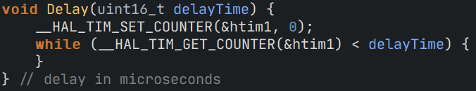
Delay (using Timer)

Slide 7
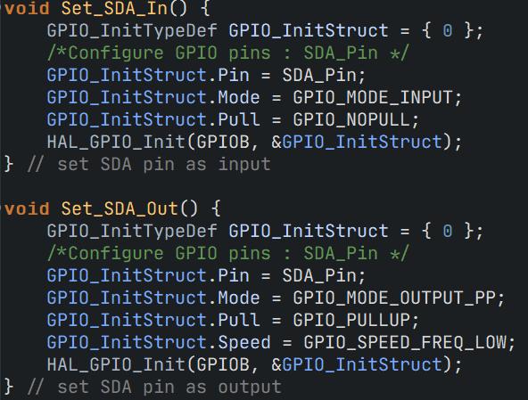
Set SDA Directions

Slide 8
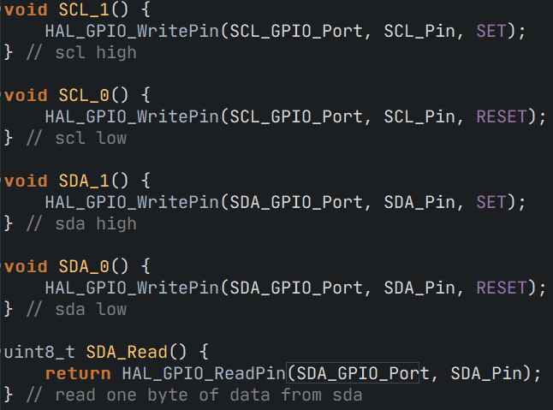
Set SCL/SDA and Read SDA pin

Slide 9
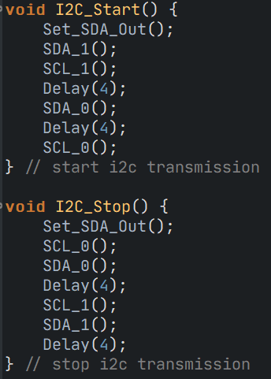
I2C Start/Stop Routine

Slide 10
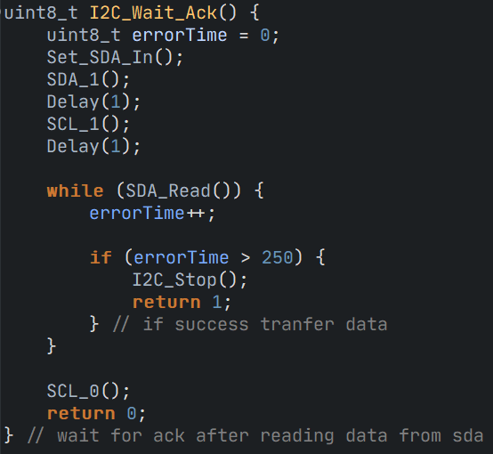
Wait ACK

Slide 11
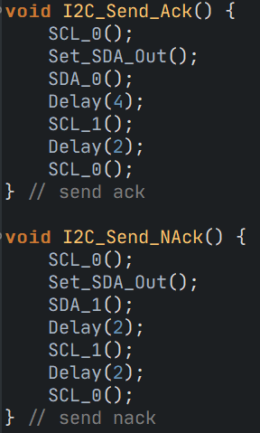
Send ACK/NACK

Slide 12
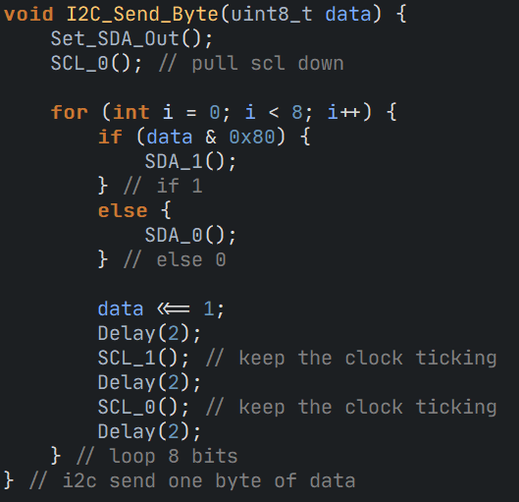
Send a byte of data

Slide 13
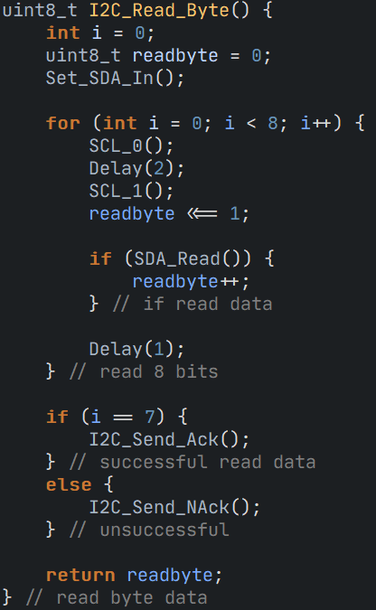
Read a byte of data

Slide 14
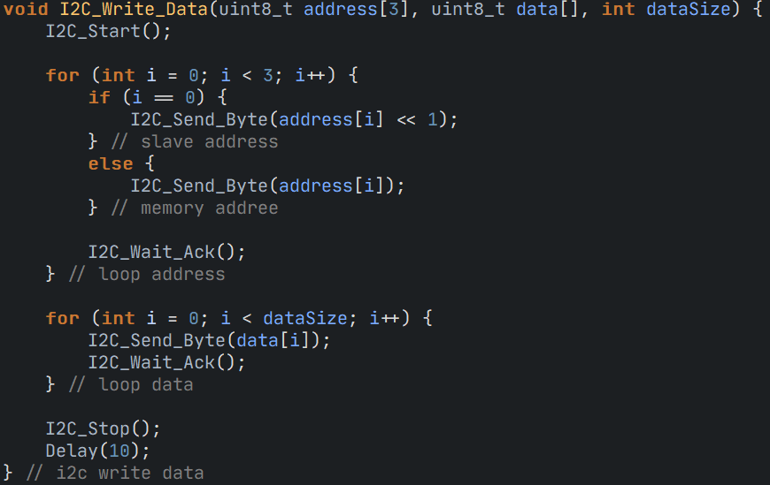
Write an array of data through I2C

Slide 15
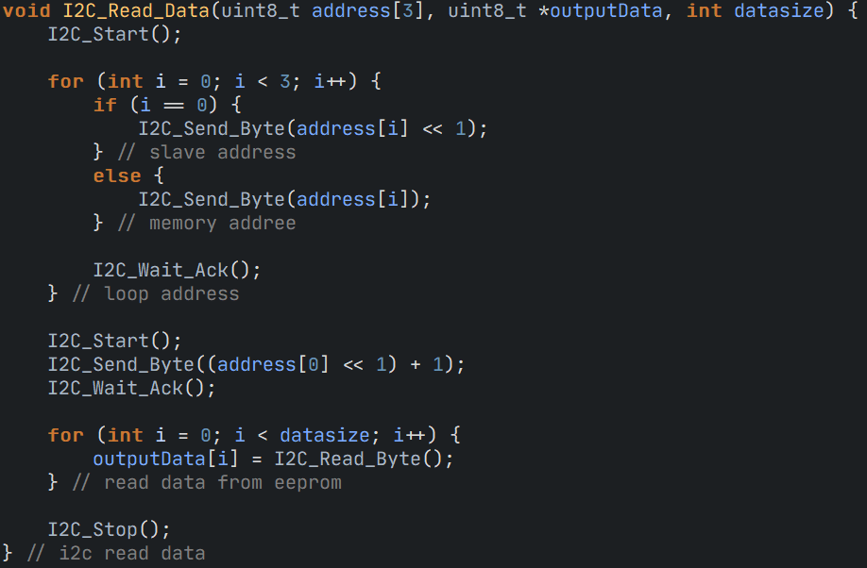
Read an array of data from I2C

Slide 16
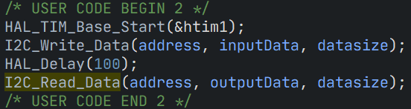
Main

Slide 17
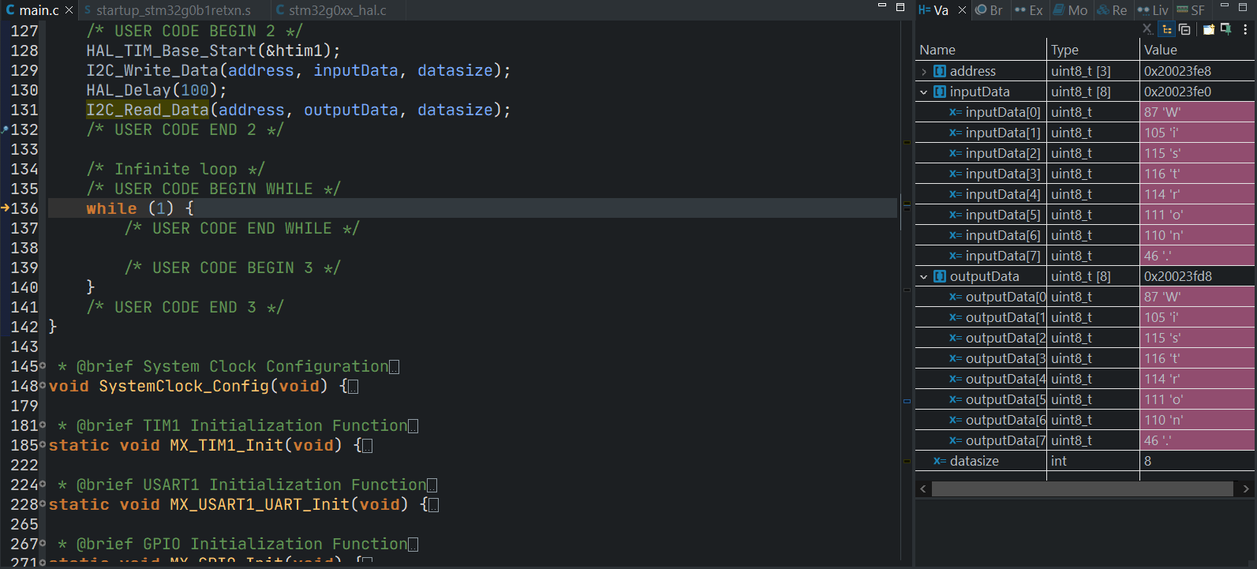
Result

Slide 18

Thank you for your listening
林冠良
Noah_Lin@wistron.com
https://github.com/popshia

